Slide 1
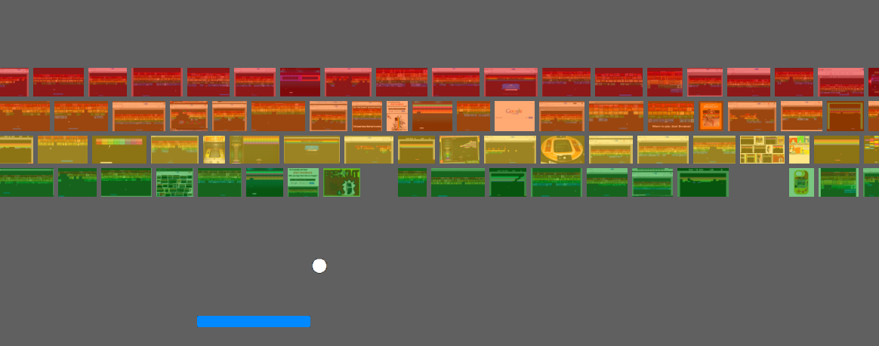
Atari Breakout &
Deep Q-Networks
DS4기 5조
박 봉현, 박 선영, 조 남영

Slide 2
Model Test

Slide 3
Flowchart
A type
B type
Terminate될 때마다 Level 변경
(순차적으로 Level0 → 1 → 2)
남은 block 이 많은 게임 레벨 선택
(남은 block=tot_block – agent_broke)
parameter setting (lr, epsilon)
(decay + 남은 block 에 따른 weight)
게임 초기화
게임 초기화
학습
학습
최고기록 갱신?
최고기록 갱신?
No
Yes
No
Yes

Slide 4
Model Tuning
Original DQN
Learning Rate
Batch Size (Final)
-----------------------------------------
History :
-----------------------------------------
Score : 56 (29, 11, 16)
Time : 62
------------------------------------------
-----------------------------------------
History : lr : 0.0001
replay memory : 30000
-----------------------------------------
Score : 86 (61, 4, 21)
Time : 93
------------------------------------------
-----------------------------------------
History : BatchSize : 64
-----------------------------------------
Score : 111 (75, 13, 23)
Time : 140
------------------------------------------

Slide 5
Final Result
Score : 1,000 Time : 20’ 00

Slide 6
Model Test
Add Title
Add Title
You can simply impress your audience and add a unique zing and appeal to your Presentations. Easy to change colors, photos and Text.
You can simply impress your audience and add a unique zing and appeal to your Presentations. Easy to change colors, photos and Text.
S
W
T
O
Add Title
Add Title
You can simply impress your audience and add a unique zing and appeal to your Presentations. Easy to change colors, photos and Text.
You can simply impress your audience and add a unique zing and appeal to your Presentations. Easy to change colors, photos and Text.

